Slide 1

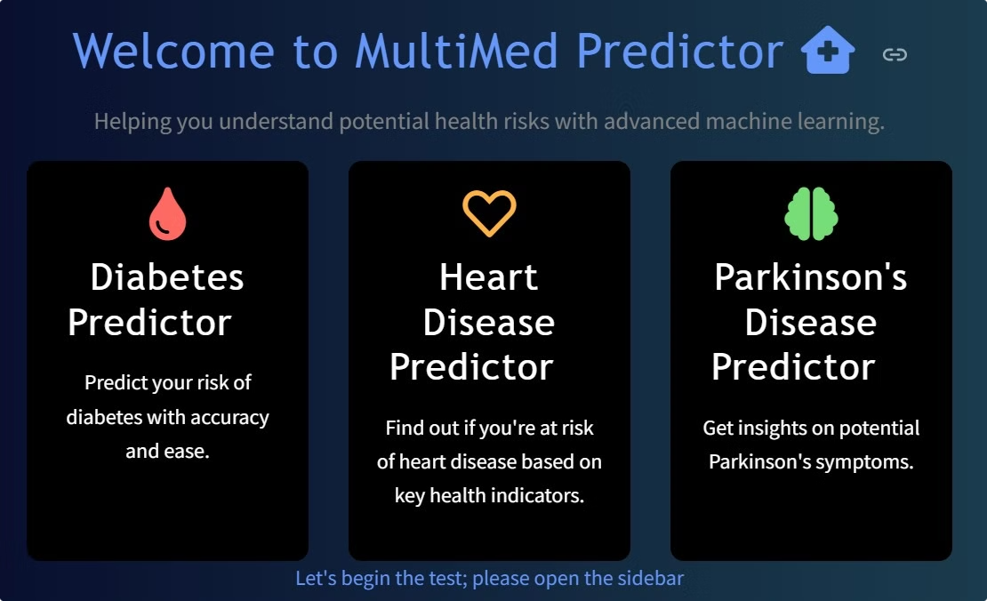
MultiMed - A Multiple Disease Detector
Leveraging the power of machine learning, this innovative project aims to revolutionize early disease prediction which includes Heart diseases, Diabetes, Parkinson's disease
Team Members:
Sourav E23CSEU1865
Aeshni Yadav E23CSEU1878
Vaishnavi Srivastava E23CSEU1888

Slide 2
Methodology
Data Collection
· Datasets for Diabetes (https://www.kaggle.com/datasets/mathchi/diabetes-data-set)
· Heart Disease (https://www.kaggle.com/datasets/johnsmith88/heart-disease-dataset)
· Parkinson’s Disease (https://www.kaggle.com/datasets/vikasukani/parkinsons-disease-data-set)

Slide 3
Methodology
Data Visualization
Data pre-processing
By sklearn library- seaborn, matplotlib are used for plotting different types of graphs for data visualization to understand data.
Implemented through a preprocessing script that handles missing values, feature scaling, and encoding.

Slide 4
Methodology
Feature Selection
Recursive Feature Elimination (RFE) was used for feature selection, ranking features by importance to understand their impact on results. The top features were retained, while the least important ones were set to their central tendency by default, allowing users the option to input custom values for improved accuracy

Slide 5
Methodology
Model Selection
Model testing and training
Classification algorithms like Logistic Regression, SVM, were evaluated to choose the best-performing model for each disease.
Recursive Feature Elimination (RFE) was used for feature selection, ranking features by importance to understand their impact on results. The top features were retained, while the least important ones were set to their central tendency by default, allowing users the option to input custom values for improved accuracy.

Slide 6

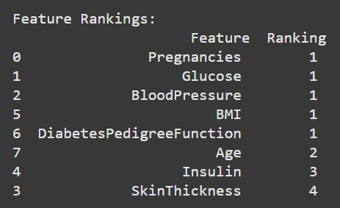
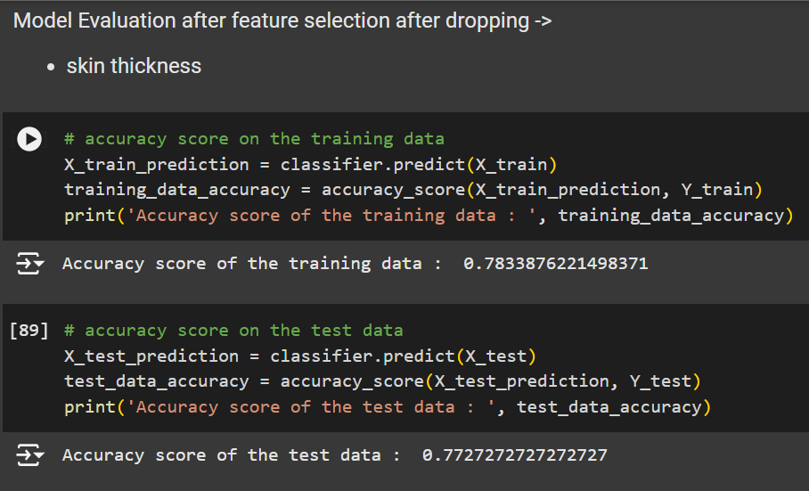
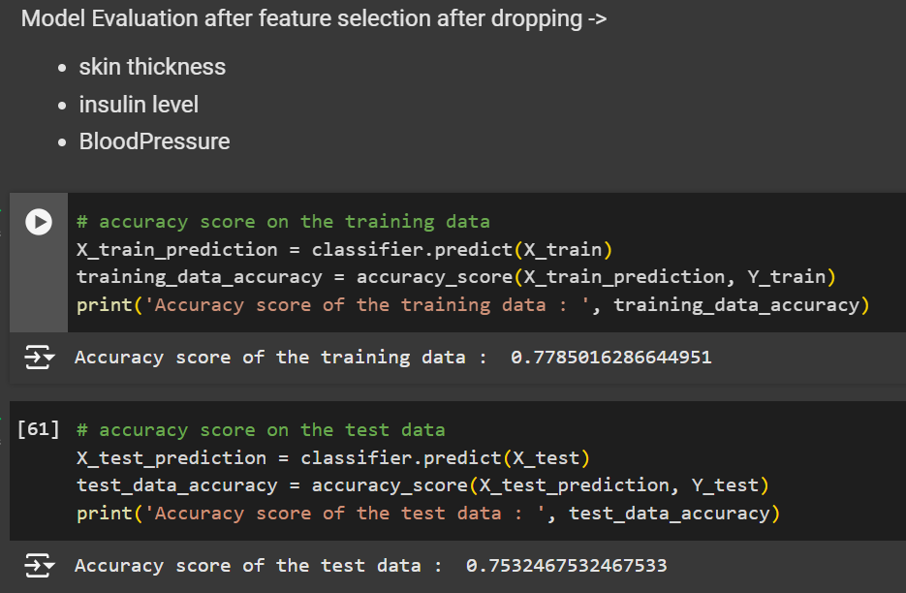
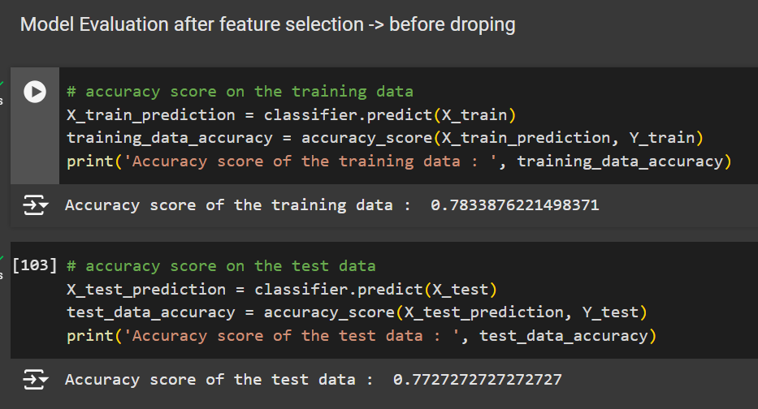
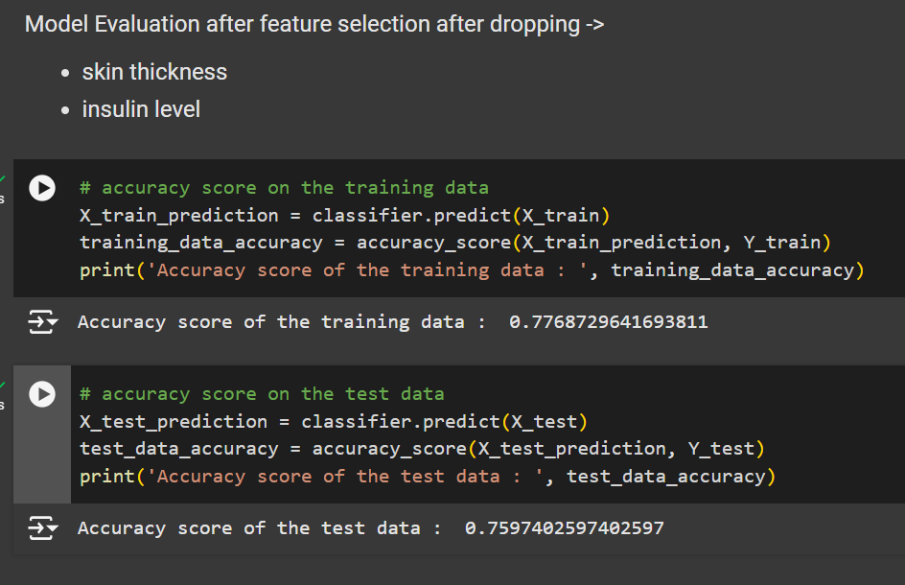
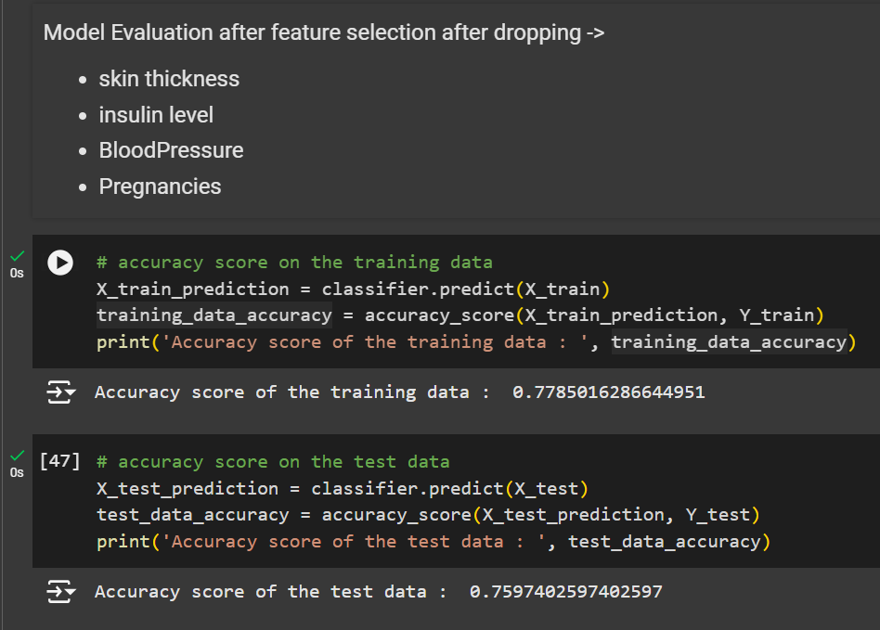
Feature Extraction : Diabetes

Slide 7
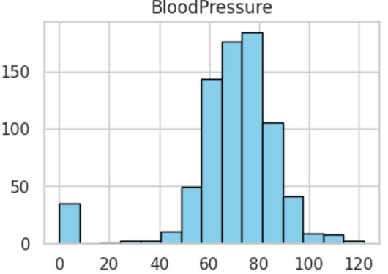
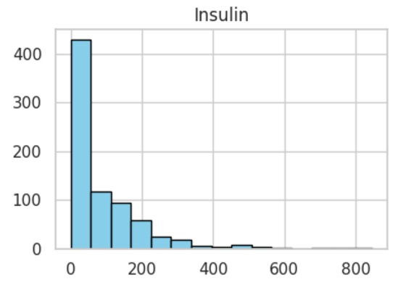
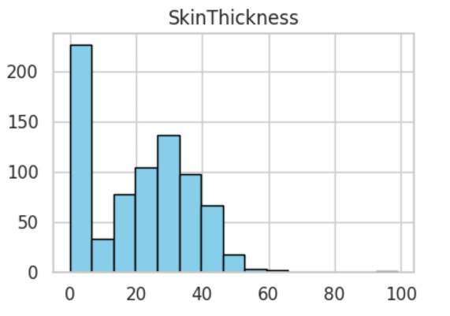
Distribution curve: Diabetes

Slide 8
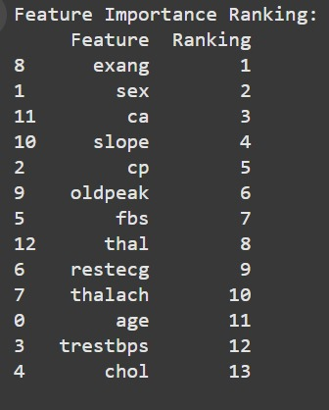
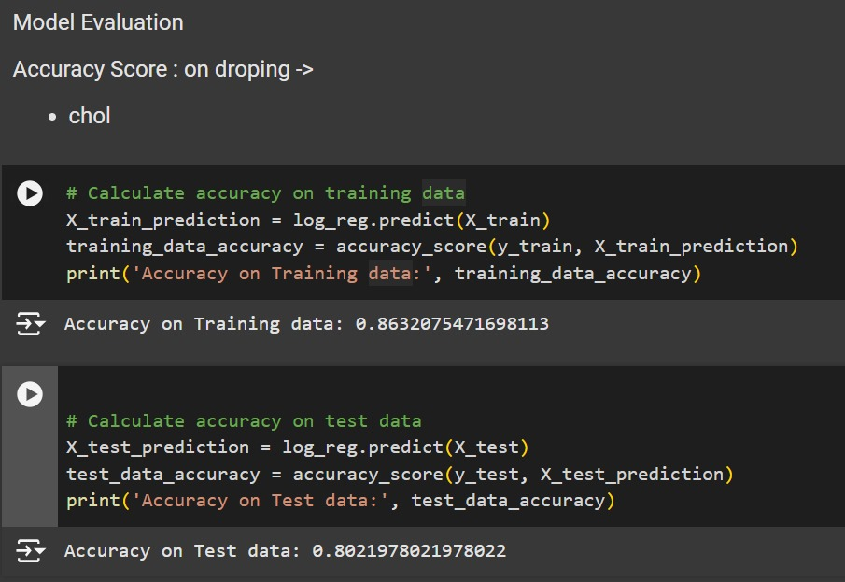
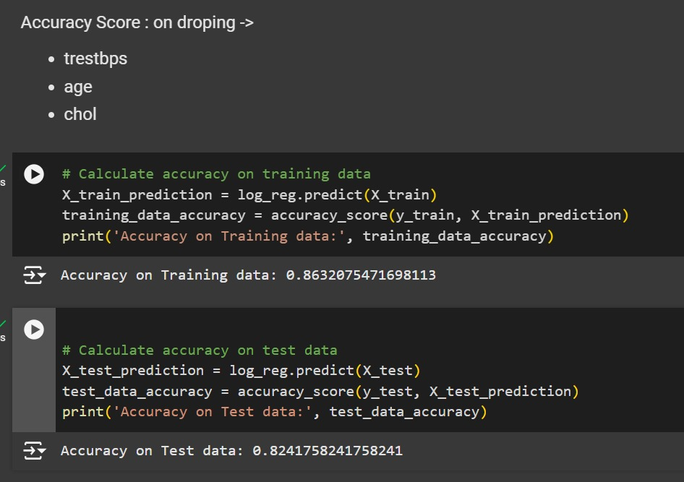
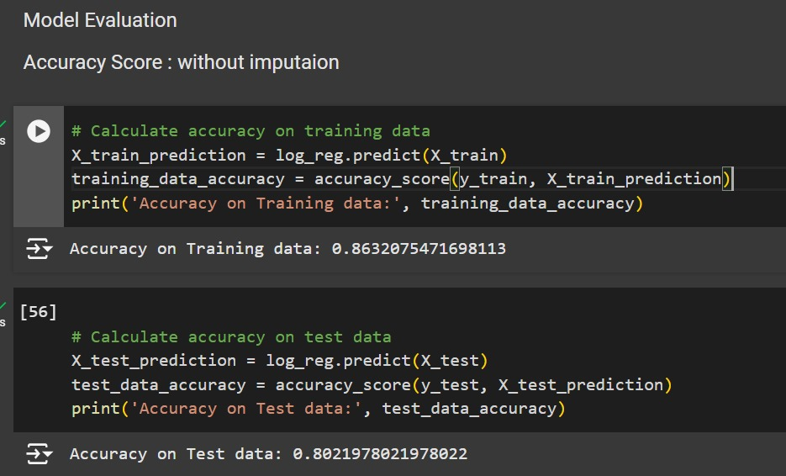
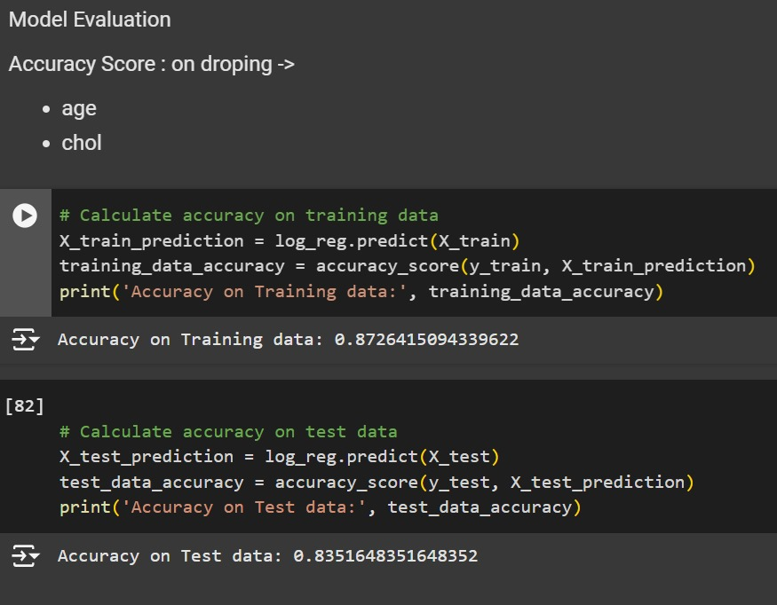
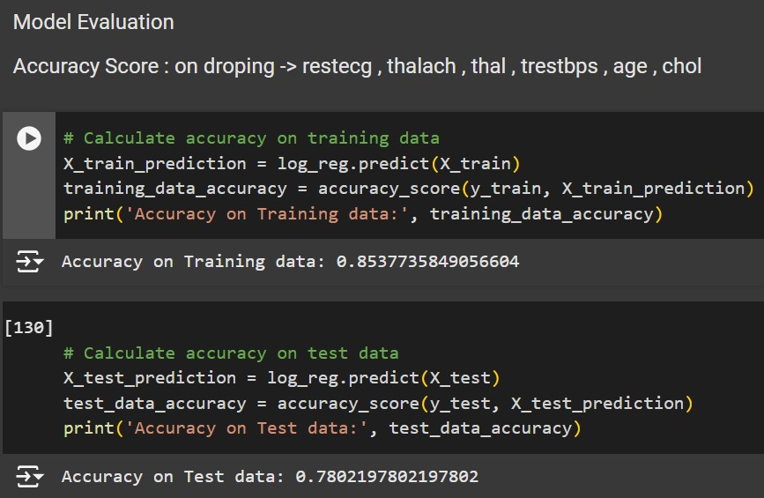
Feature Extraction: Heart Disease

Slide 9
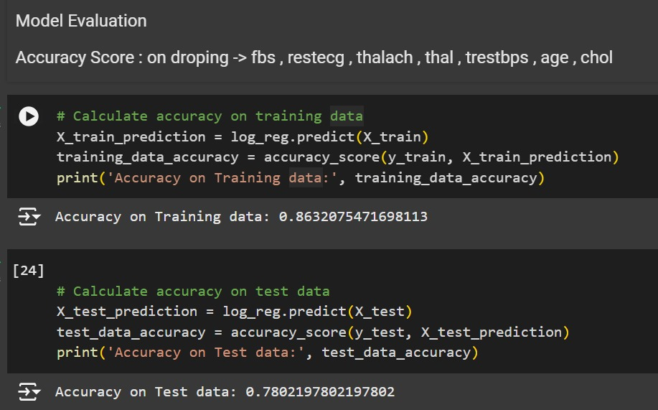
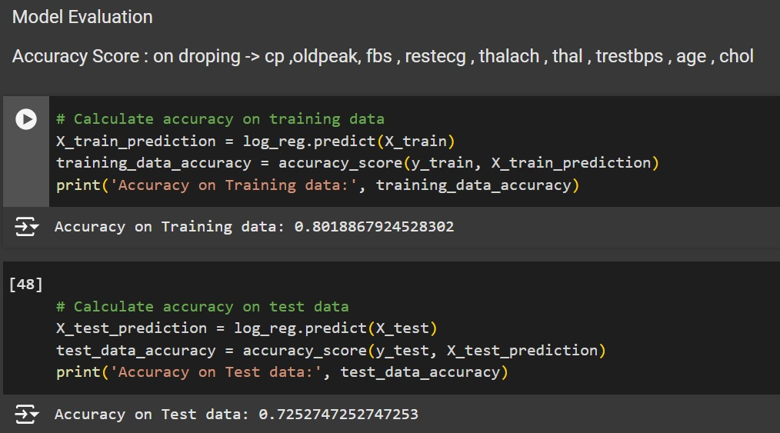
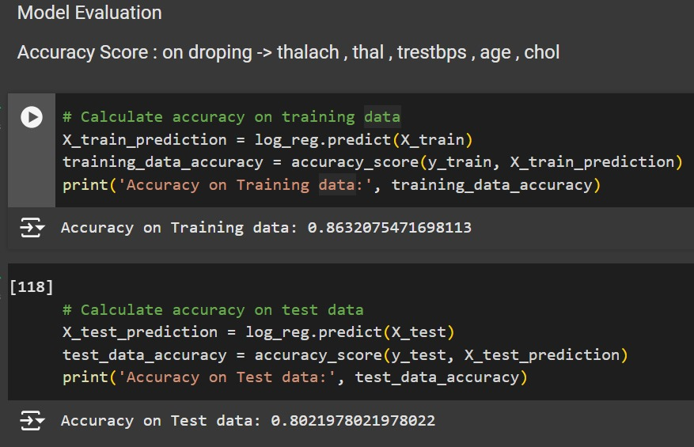
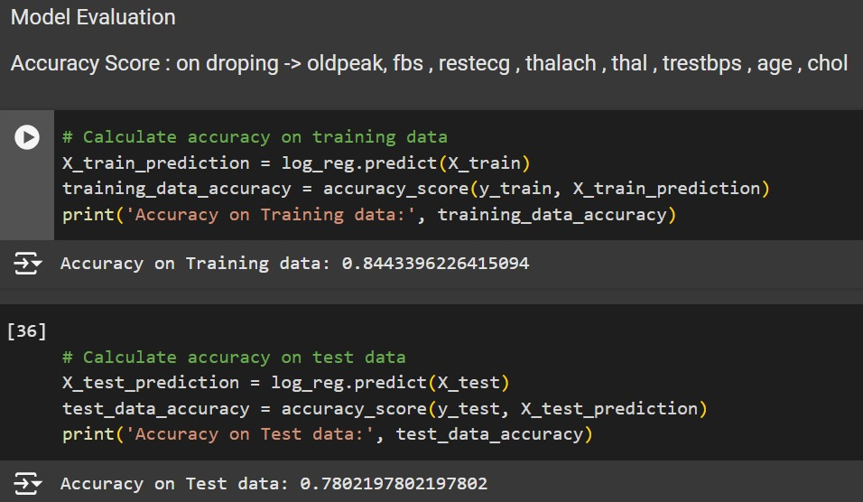
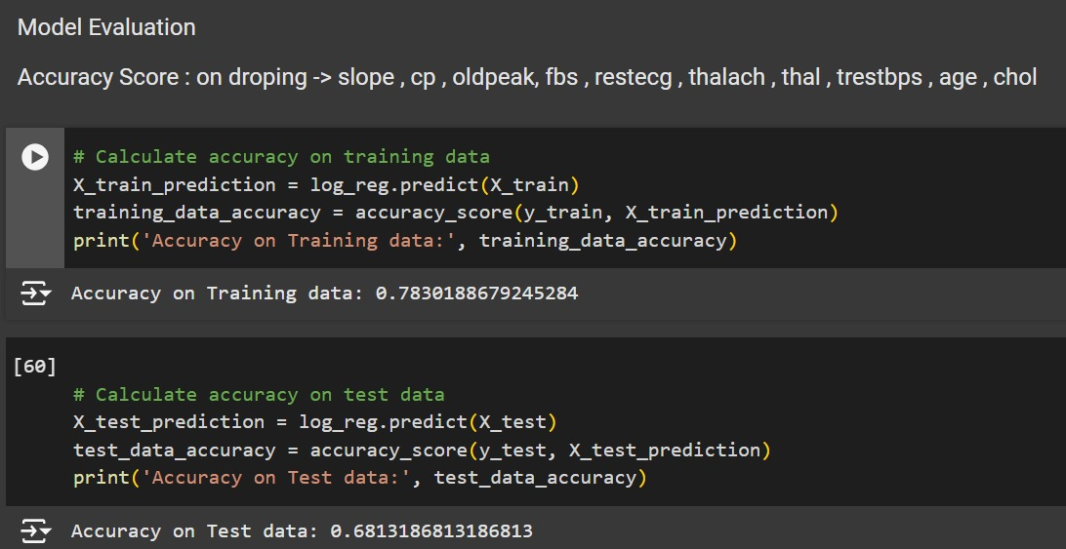
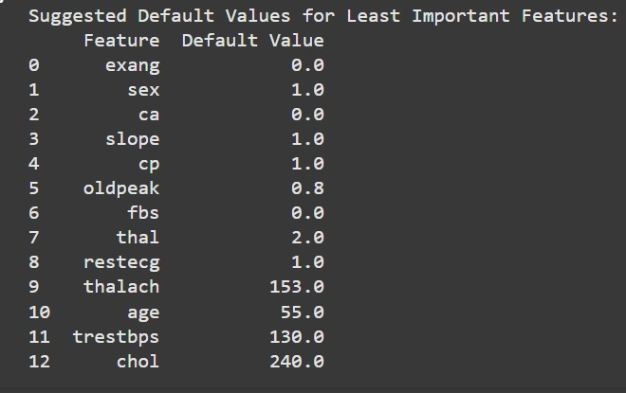
Feature Extraction: Heart Disease

Slide 10
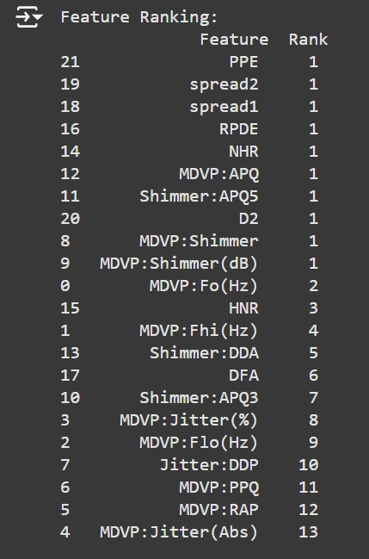
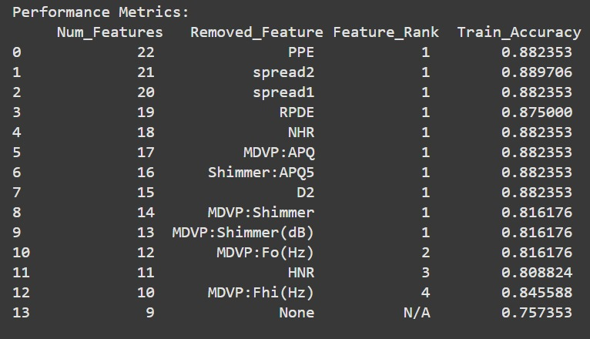
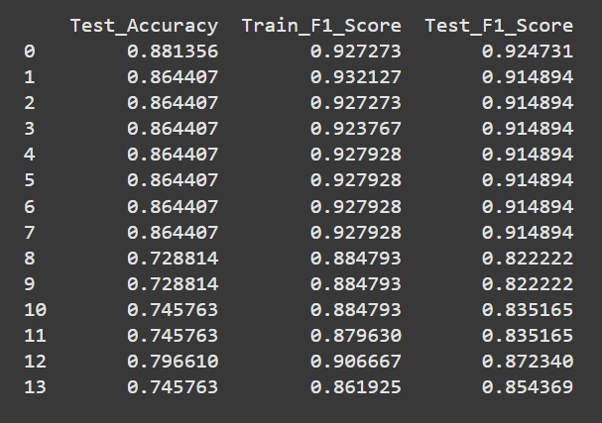
Feature Extraction: Parkinson’s Disease

Slide 11
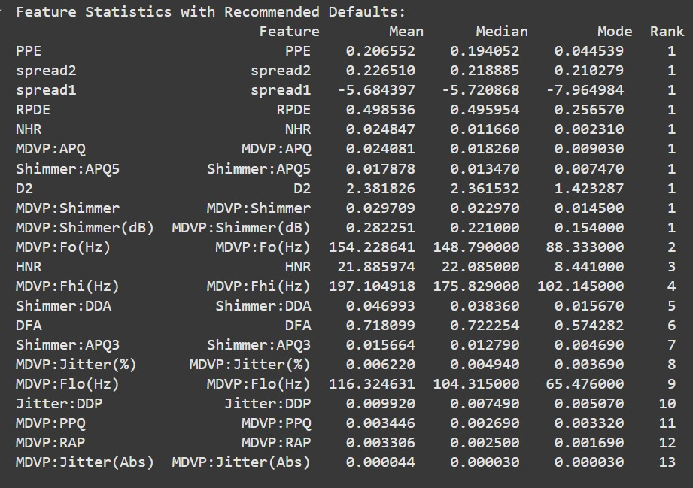
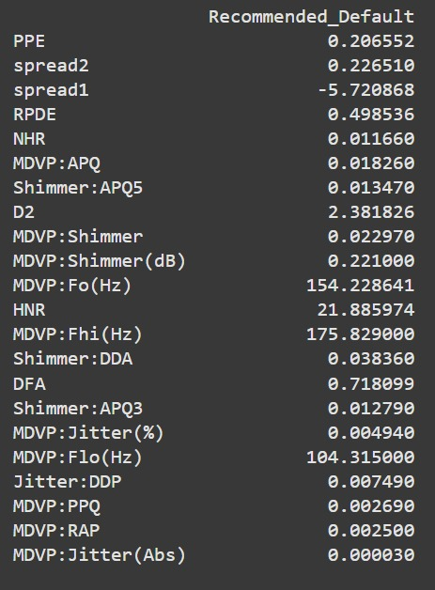
Feature Extraction: Parkinson’s Disease

Slide 12
Thank you!!

